Slide 1
Volcanology: Native knowledge and colonial powers
Contributors: Ery C. Hughes
Keywords: volcanology, European colonialism, environmental determinism, Indigenous peoples
Location: Antarctica, Aotearoa New Zealand, France, Guatemala, Indonesia, Martinique, Montserrat, Netherlands, Papua New Guinea, Solomon Islands, South Georgia and the South Sandwich Islands, Spain, Trinidad, UK
People: Charles Stehn, Karl Sapper, Cecil King Wungi
Last updated: August 15, 2021
Visit https://geo-context.github.io for the teacher’s companion guide to these slides.

Slide 2
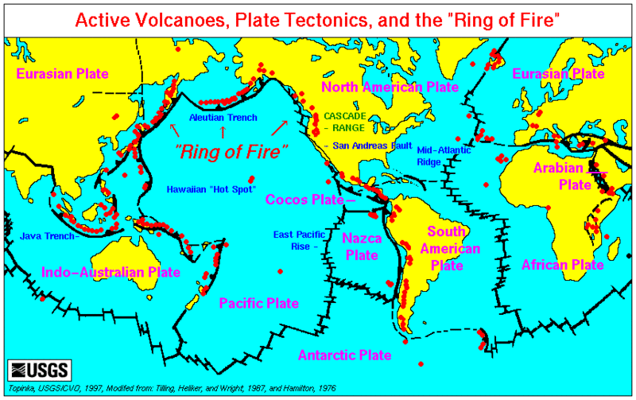


European colonisation of volcanic regions
Fertile volcanic soils for plantations worked on by enslaved people (e.g., sugar in Martinique)
Volcanic islands provide strategic assets such as harbors, outposts, refuelling stations, military bases, and further land-rights, etc.
Mining of direct resource (e.g., sulfur, used in the vulcanisation of rubber, manufacture of matches, dyes, pharmaceuticals, and gunpowder)
Examples of volcanic regions colonized by Europeans.
Credit: U.S. Geological Survey

Slide 3
Volcano observatories
Some volcano observatories were set up by colonial governing bodies in response to volcanic crises, e.g.:
Observatoire Volcanologique et Sismologique de Martinique (OVSM) – established 1903 after the 1902 eruption of Mount Pelée – currently run by Institut de Physique du Globe de Paris [IPGP] – Martinque is an overseas department of France
Rabaul Volcanological Observatory (RVO) – established 1938 after the 1937 eruption by the Australian government – volcanologist (Dr Charles Stehn) advice sought as to whether Rabaul should remain the capital²
Centre for Volcanology and Geological Hazard Mitigation (CVGHM) Indonesia – established 1918 by the government of the Netherlands East Indies³

Slide 4
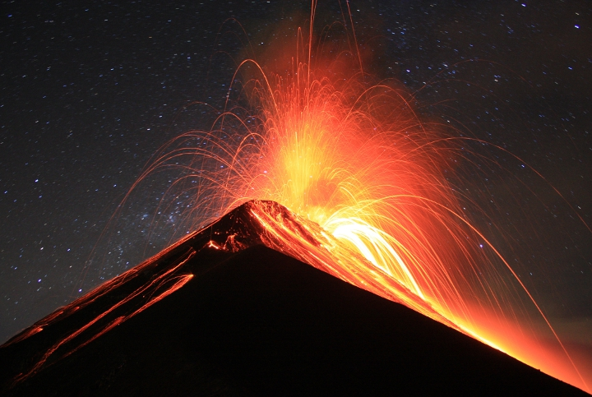
Records of historical eruptions
Pozzo+2016⁴
Colonial archives can provide detailed reports of volcanic eruptions (e.g., eyewitness accounts, official correspondence, government documents, ship logs, etc.), data that cannot be derived solely from geological evidence⁴
1717 eruption of Volcán de Fuego, Guatemala: Spanish colonisation resulted in extensive written records – compilation of documents gave geological information, event timings, and impacts⁵
However, oral traditions and pictorial documents from Indigenous peoples also provide detailed accounts of volcanic activity that can go beyond these written, colonial documents^{6,7}
Strombolian eruption of Volcán de Fuego, Guatemala.
Wikimedia Commons/Kevin Sebold

Slide 5
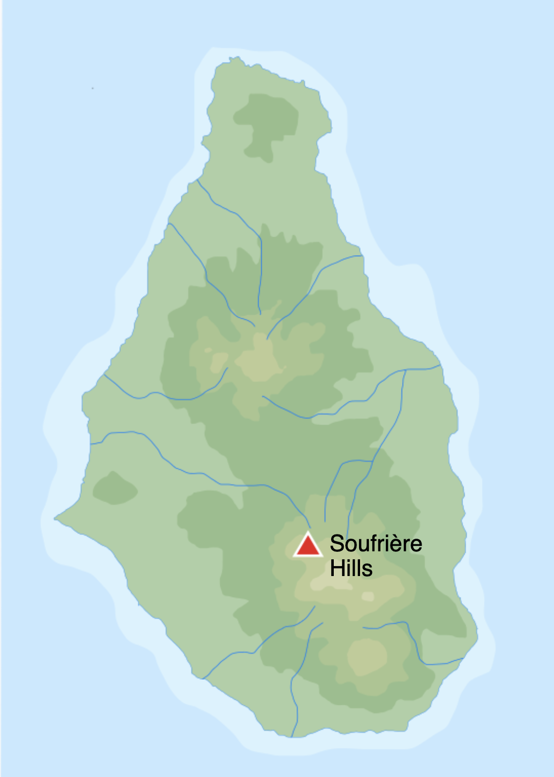
1995 eruption of Montserrat
Colonised by (mostly) the English from 17th century, currently a British Overseas Territory
Up to 10,000 enslaved African people by late 18th century involved in sugar plantations⁸
Monserrat Volcano Observatory (MVO) set up from 1995 (officially 1998) due to volcanic activity – initially run by the British Geological Survey (BGS)
Now run by Seismic Research Centre, University of the West Indies, Trinidad⁹
Map of Monserrat in the Lesser Antilles with the location of Soufrière Hills.
“… it explores the role of geological sciences – which were both reshaped by the eruption and came to hold political power over the island. External geoscientists (mostly British) had to negotiate the colonial dynamics of Montserratian politics as their knowledge came to have considerable power over the islanders. Yet geological science was also changed by Montserrat, not only in its knowledge but in its approach to risk – and this approach, driven by the concerns of Whitehall (the seat of the UK government), itself enabled the re-colonisation of Montserratian land.”⁸
Wikimedia Commons.

Slide 6
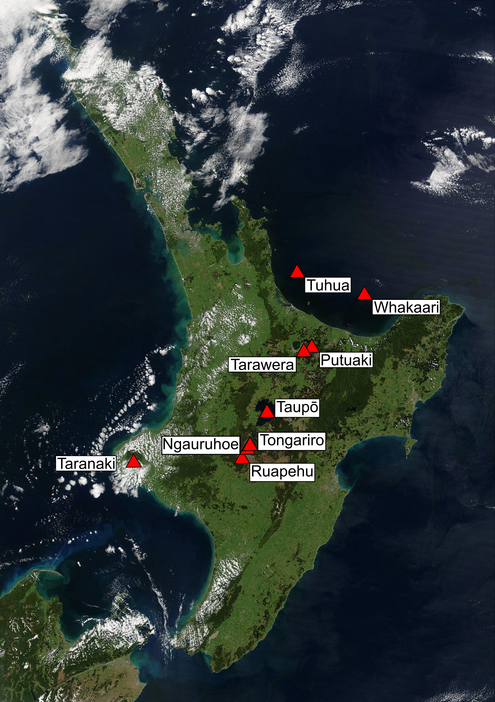
Native names
Te reo Māori names of Aotearoa’s (New Zealand) volcanoes.
European colonizer’s often renamed features in the landscape, including volcanoes.
Cook renamed volcanoes in Aotearoa (New Zealand) – many have had their Te reo Māori names restored/officially incorporated.
Cascades (US west coast): known as Yamakiasham Yaina (Mountains of the Northern People) – renaming has erased the Native American names¹⁴.
Edited from Wikimedia Commons.

Slide 7
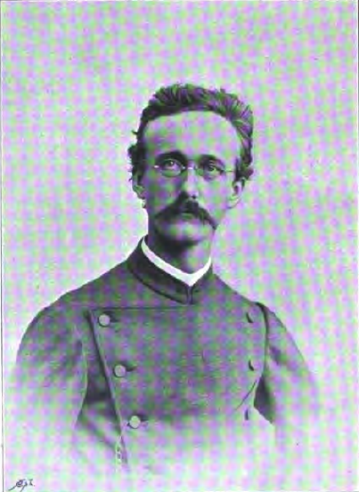
Karl Sapper (1866–1945)
Extensive research in Central America and S. Mexico
Defined early scale of eruptions based on total quantity of erupted material¹⁵, used in the “dust veil index”¹⁷
Blended scientific knowledge and coffee plantation management¹⁸
Believed “the native population was better suited to working the fields than white colonisers” and in anthropogeography (direct relationship between soil, race, climate, and history)¹⁹
Karl Sapper (1866–1945).
Wikimedia Commons.

Slide 8
References
https://www.boell.de/en/2017/05/30/ocean-governance-who-owns-ocean
Johnson, R., 2013. Fire Mountains of the Islands: A history of volcanic eruptions and disaster management in Papua New Guinea and the Solomon Islands. ANU Press. DOI 10.26530/OAPEN_462202
Van Padang, M.N. and Van Padang, M.N., 1983. History of the volcanology in the former Netherlands East Indies. Rijksmuseum van Geologie en Mineralogie.
Pyle, D.M., Barclay, J. Historical records of volcanic eruptions deserve more attention. Nat Rev Earth Environ 1, 183–184 (2020). doi 10.1038/s43017-020-0044-z
Hutchison, A. A., Cashman, K. V., Williams, C. A., & Rust, A. C. (2016). The 1717 eruption of Volcán de Fuego, Guatemala: cascading hazards and societal response. Quaternary International, 394, 69–78. doi 10.1016/j.quaint.2014.09.050
Swanson, D. A. (2008). Hawaiian oral tradition describes 400 years of volcanic activity at Kīlauea. Journal of Volcanology and Geothermal Research, 176(3), 427-431. doi 10.1016/j.jvolgeores.2008.01.033
Martin-Del Pozzo, A. L., Rodríguez, A., & Portocarrero, J. (2016). Reconstructing 800 years of historical eruptive activity at Popocatépetl Volcano, Mexico. Bulletin of Volcanology, 78(3), 18. doi 10.1007/s00445-016-1010-y
Donovan, A. (2021). Colonising geology: volcanic politics and geopower. Political Geography, 86, 102347. doi 10.1016/j.polgeo.2021.102347
Aspinall, W., Loughlin, S. C., Michael, F. V., Miller, A. D., Norton, G. E., Rowley, K. C., Sparks, R. S. J., & Young, S. R. (2002). The Montserrat volcano observatory: Its evolution, organization, role and activities. In T. H. Druitt, & B. P. Kokelaar (Eds.), The eruption of Soufrière Hills Volcano, Montserrat, from 1995 to 1999 (Vol. 21). London, Memoirs: Geological Society. doi 10.1144/gsl. mem.2002.021.01.04.
https://www.nzgeo.com/stories/the-obsidian-island/
https://gazetteer.linz.govt.nz/place/6961
https://en.wikipedia.org/wiki/Putauaki
https://en.wikipedia.org/wiki/Mount_Taranaki
https://www.discovermagazine.com/planet-earth/lets-return-the-cascade-volcanoes-to-their-original-names
Alvarado and Patino (2016) The history of volcanology in Costa Rica: from the Amerindian legends to the beginning of the twenty-first century. From Mayer, W., Clary, R. M., Azuela, L. F., Mota, T. S. & Wołkowicz, S. (eds) 2017. History of Geoscience: Celebrating 50 Years of INHIGEO. Geological Society, London, Special Publications, 442, 127–140. doi 10.1144/SP442.35
Sapper, K. (1927) Vulkankunde, Engelhorn Verlag, Stuttgart.
Newhall, C. G., & Self, S. (1982). The volcanic explosivity index (VEI) an estimate of explosive magnitude for historical volcanism. Journal of Geophysical Research: Oceans, 87(C2), 1231–1238. doi 10.1029/JC087iC02p01231
Lamb, H. H. (1970) Volcanic dust in the atmosphere; with a chronology and assessment of its meterological significance, Phil. Trans. R. Soc. London, 266:425–533.
Gibbings, J (2020) “Their debts follow them into the afterlife”: German settlers, ethnographic knowledge, and the forging of coffee capitalism in nineteenth-century Guatemala, Comparative Studies in Society and History, 62(2):389–420. doi 10.1017/S0010417520000092
Kophamel, W. (2020). Race and soil. Geography, ethnology, and Nazism. Mètode Science Studies Journal, 10. DOI: 10.7203/metode.10.13560

